Slide 1

Self-Driving AI Car Simulation
Harsh Gupta - 101916125 - CS12
Shubham Tiwari - 101916126 - CS12
Harmaan Jeet Singh - 101917027-CSE2
Preetinder Singh - 101917066-CSE3

Slide 2
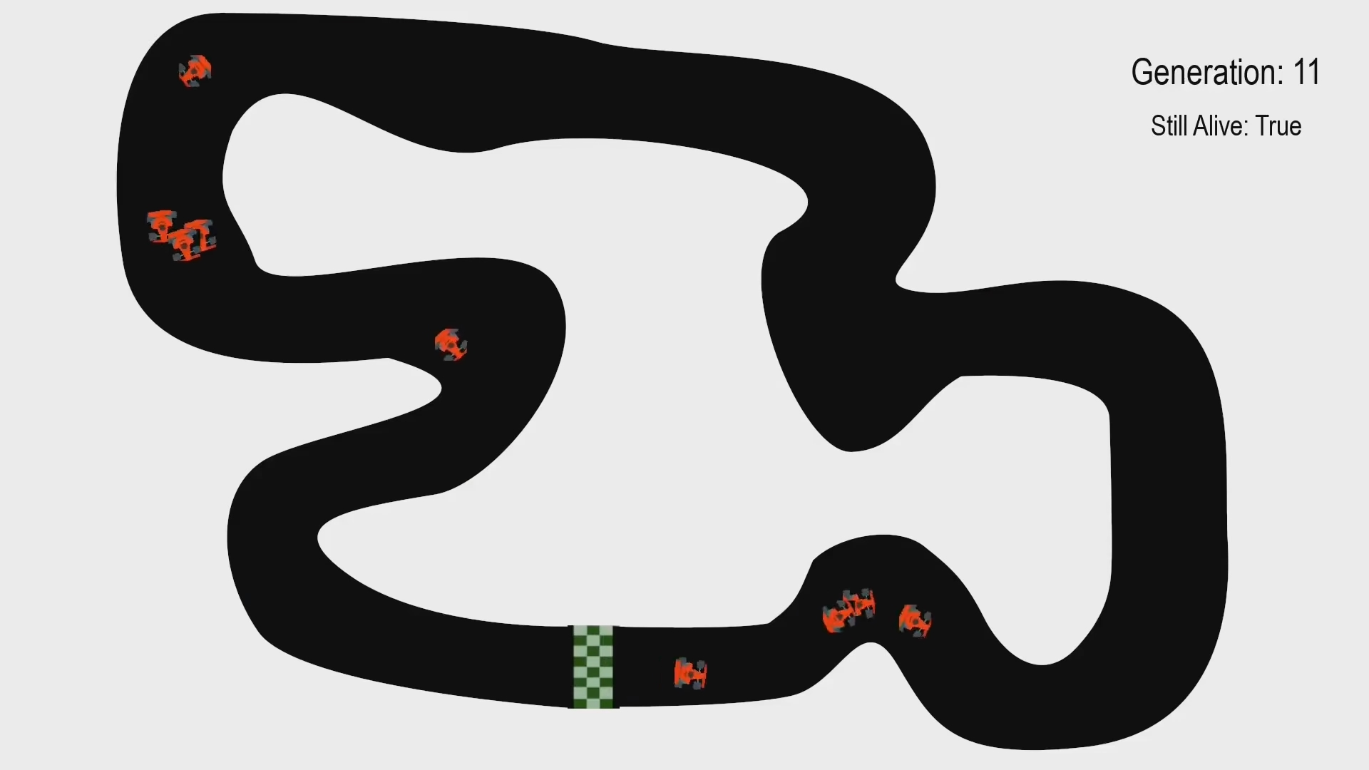
Simulation
Using Genetic and reinforcement learning techniques.
Using simple algorithm called NEAT..
Progressive simulation i.e Starts from ZERO.
Can drive on any random path given finite time.
Beautiful animation using pygame.

Slide 3
What is NEAT?
NeuroEvolution of Augmenting Topologies (NEAT) is a genetic algorithm (GA) for the generation of evolving artificial neural networks. Its uses concepts like mutation , speciation , cross over ETC to train the model over time. NEAT is one of the best algo to date for evolving network topologies.
NEAT

Slide 4
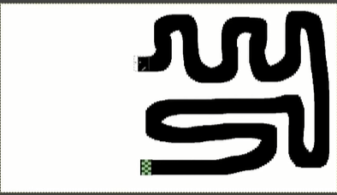
Map Generation
This is simple map which is created by Adobe Photoshop or you can use your convenient software like Microsoft Paint etc. You can use pen tool to create smoother curves. You need to draw track in black and background in white with track starting and end position be [830, 920] and track resolution must be 1920 * 1080.

Slide 5
Model Details
The model is neural network with 5 input and 4 output neurons.
Initially the cars shall have zero intelligence but each action taken they may receive a reward/penalty.
This is implemented using Fitness matrix. In the simulation fitness of a car increases depending on the the distance travelled without crashing.
After Each generation we will be selecting the best cars and applying crossover genetics, speciation and mutation to further increase training capability.
Soon a alpha species will emerge which will be able to drive faster than others

Slide 6
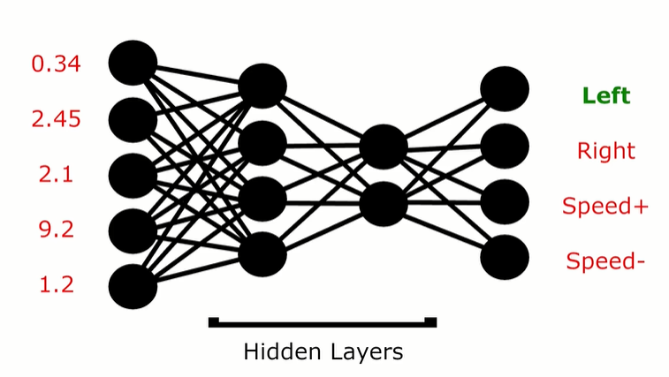
Sample NEAT Network

Slide 7
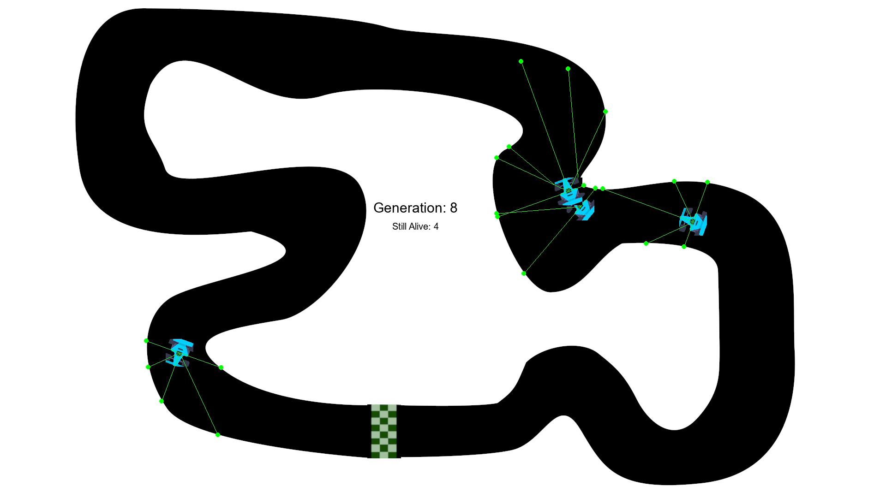

Slide 8
Progress Chart:
Steps: | Status
1. Map generation
2. NEAT implementation
3. Pygame implementation
4. Conversion to executable file
5. Version 1.0 testing
6. Simulation Speed adjustable
7. Simulation parameters adjustable

